Slide 1

VIDYAVARDHINI’S COLLEGE OF ENGINEERING AND TECHOLOGY
K.T. MARG VASAI ROAD, DIST. PALGHAR - 401202
Department of Artificial Intelligence and Data Science
TOPIC
Prediction of ADHD using
Machine Learning

Slide 2
Team Details:
BHAVYA JIGNESH DAMANI (ROLL NO. 09)
NIHAAL DHANESH GHARAT (ROLL NO. 18)
AAYUSH HEMANT PATIL (ROLL NO. 42)
Project Guide:
MISS SNEHA YADAV ( GUIDE )
MISS BHAVIKA GHARAT (CO-GUIDE )

Slide 3
Table of Contents :
Abstract
Introduction
Problem Statement
Proposed System
Literature Survey
Hardware/Software Requirement
Result and Discussion
Future Scope
Conclusion
Refrences

Slide 4
Abstract
Prediction of ADHD Using Statistical and Machine Learning Algorithms is an emerging field that aims to improve the accuracy and efficiency of ADHD diagnosis. Traditional diagnostic methods for ADHD are often subjective and time-consuming, relying on clinical interviews and behavioral assessments. Machine learning (ML) and statistical models offer a data-driven approach by analyzing large datasets, including behavioral patterns, genetic information, neuroimaging data, and other biomarkers.
These algorithms can identify subtle patterns that may not be easily detected by human observation. Techniques such as decision trees, support vector machines, and neural networks are commonly used to classify ADHD cases or predict the likelihood of the disorder in individuals. Statistical models can also help in feature selection, identifying key variables associated with ADHD symptoms.
The integration of these technologies holds promise for earlier, more accurate ADHD diagnoses, which can lead to better treatment outcomes. However, challenges remain, such as ensuring data quality, addressing ethical concerns, and developing models that generalize well across diverse populations.

Slide 5
Introduction to ADHD
•ADHD stands for Attention Deficit Hyperactivity Disorder.
•It’s a brain disorder that affects how you pay attention, sit still, and control your behavior.
•It happens in children and teens and can continue into adulthood.
•ADHD is one of the most commonly diagnosed mental disorders in children.
.
•It’s usually spotted during the early school years, when a child begins to have problems paying attention.

Slide 6
ADHD Types and Symptoms in Children
•BE EASILY DISTRACTED
•Have poor listening skills
•Forget things easily
•Often lose things
•Daydream a lot
•Have trouble paying attention
•INterrupt Others

Slide 7
Problem Statement
ADHD is a highly prevalent disorder in children and has a high chance of persisting in adulthood. The development of individualized, efficient, and reliable treatment strategies is limited by the lack of understanding of the underlying neural mechanisms. ADHD is simultaneously associated with multiple factors across cognitive, genetic, and biological domains. Machine learning algorithms are more capable of detecting complex interactions between multiple variables than conventional statistical methods. Hence, this work deals with detection of ADHD by machine learning

Slide 8
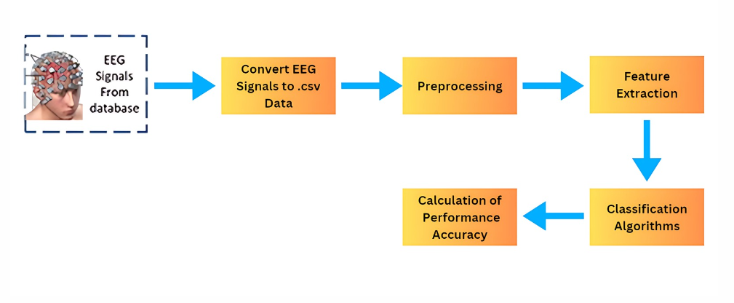
Proposed System

Slide 9
Objectives
To conduct exploratory data analysis on ADHD dataset.
To compare machine learning methods and logistic regression method in ADHD detection.
To generate the features of EEG signal of 19 channels
To model the ADHD problem by methods namely logistic regression, Decision tree (DT) and Random Forest (RF
To tune the hyper parameters of DT and RF to avoid overfitting issues

Slide 10
Research Gap
There are many works related to ADHD Prediction with use of EEG Signal but all they have use are upto 2 to 5 channels to predict the data, with accuracy of 50 % to 60%
Our Project is using all the 19 channels to predict the data which makes a difference in our project which is efficiency, As the model is using all the 19 channels with having accuracy upto 95% and above.

Slide 11
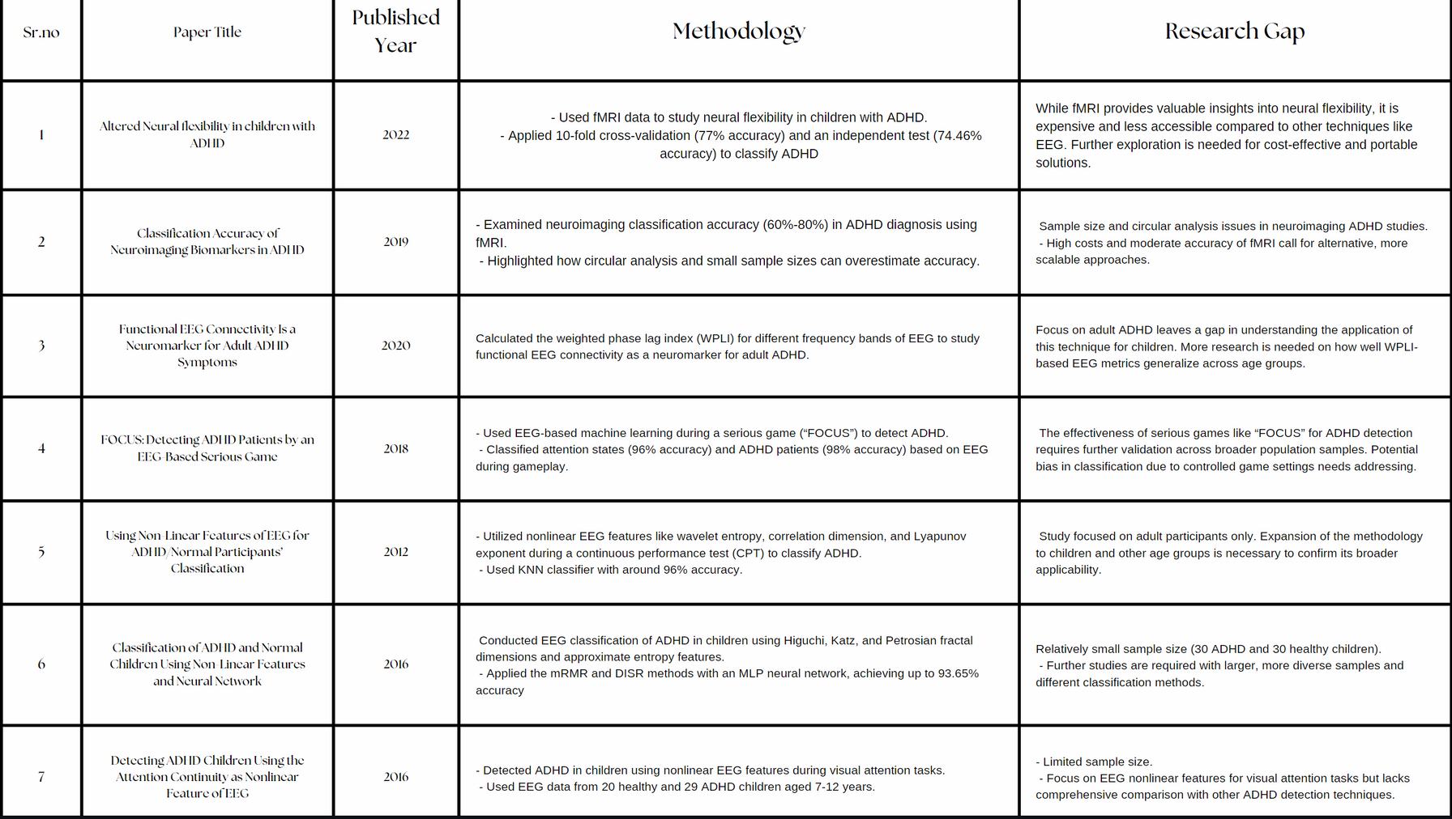
Literature Survey

Slide 12
Hardware and Software Requirments ?
Hardware Details:
Laptop with a minimum of 8 GB RAM and 512 GB storage.
Good internet connection.
Software Details:
Programming Languages:
Python: For data processing, analysis, and visualization using its rich library ecosystem.
Data Visualization Libraries:
Matplotlib: For static, interactive, and animated visualizations.
Seaborn: For statistical visualizations built on Matplotlib, simplifying complex visualizations.
Data Manipulation Libraries:
Pandas: For data manipulation and analysis with DataFrames for tabular data.
NumPy: For numerical computations with large, multi-dimensional arrays.
Integrated Development Environment (IDE):
Jupyter Notebook: For interactive coding and data visualization and enables easy sharing.

Slide 13
Future Scope
This work uses the open-source dataset of EEG signal presented on IEEE website. The signals are processed in time domain only and frequency domain are left for future work. Only three features are used here and three machine learning methods (DT, RF and logistic) are compared.

Slide 14

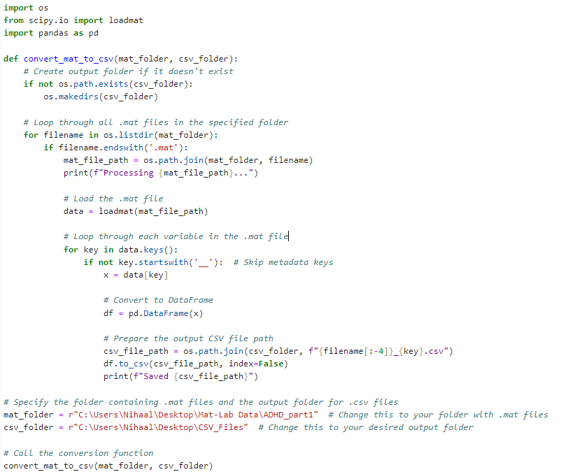
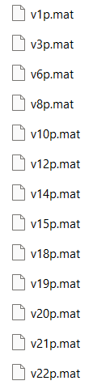
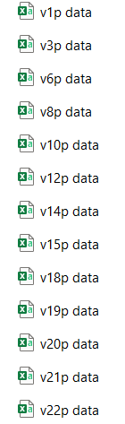
Result & Discussion
File Conversion from .mat to .csv :
.mat .csv

Slide 15
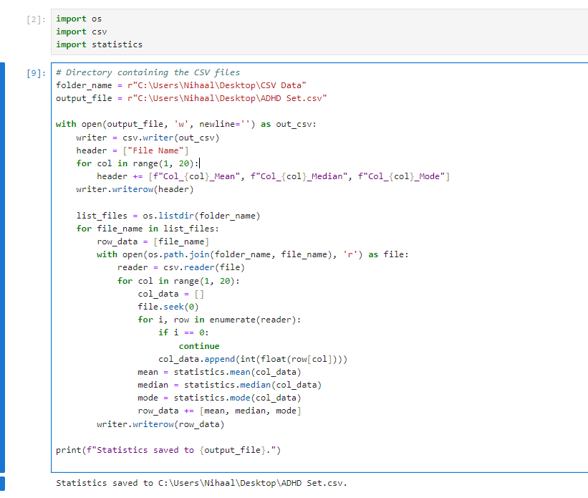
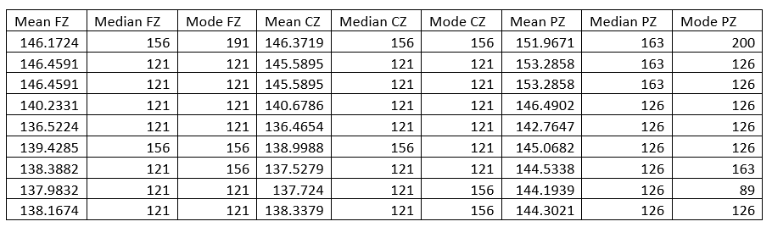
Result & Discussion
Data extracting using features :

Slide 16
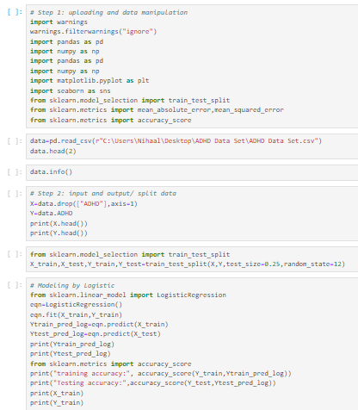
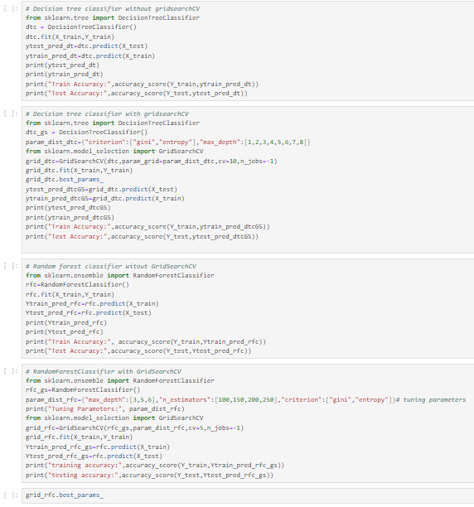
Result & Discussion
Applying the Algorithms :

Slide 17
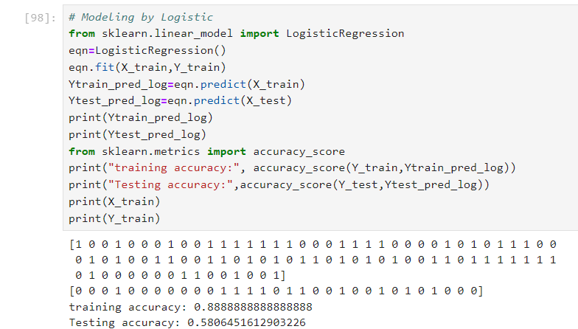
Result & Discussion
Output :
I ] Accuracy using Logistic Regresssion Algorithm :

Slide 18
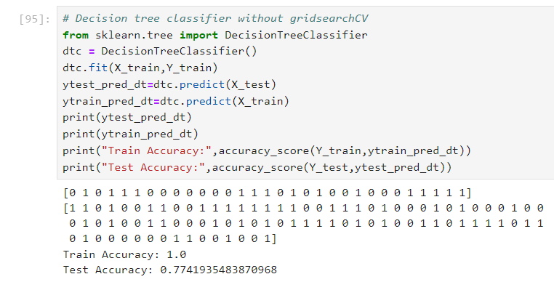
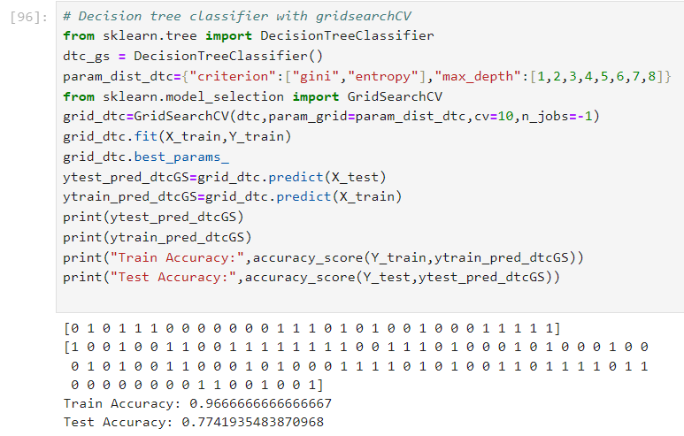
Result & Discussion
Output :
2 ] Accuracy using Decision Tree Algorithm :

Slide 19
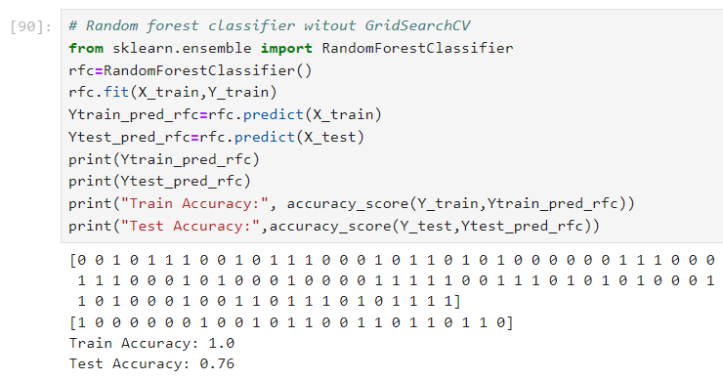
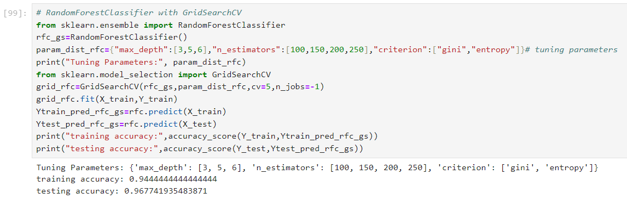
Result & Discussion
Output :
3 ] Accuracy using Random Forest Algorithm :

Slide 20


Conclusion
The project titled "Prediction of ADHD Using Machine Learning" presents a mini-project aimed at developing a machine learning (ML) model to predict Attention Deficit Hyperactivity Disorder (ADHD) in children. ADHD is a common neurodevelopmental disorder characterized by symptoms like hyperactivity, inattention, and impulsivity. Traditional diagnostic methods rely on neuroimaging and manual assessments, which can be complex and costly. The project explores the potential of EEG (Electroencephalography) signals to aid in diagnosing ADHD, leveraging ML algorithms such as Logistic Regression, Decision Tree (DT), and Random Forest (RF).
The key contributions include using EEG data from 19 channels, unlike prior studies that limited analysis to fewer channels. The model incorporates time-domain features and compares the performance of different algorithms. Hyperparameter tuning for DT and RF is applied to avoid overfitting. The dataset used consists of 121 children, with ADHD and control groups.

Slide 21
References
Yin, W.; Li, T.; Mucha, P.J.; Cohen, J.R.; Zhu, H.; Zhu, Z.; Lin, W. Altered Neural Flexibility in Children with Attention-Deficit/Hyperactivity Disorder. Mol. Psychiatry 2022, 27, 4673–4679.
Pulini, A.A.; Kerr, W.T.; Loo, S.K.; Lenartowicz, A. Classification Accuracy of Neuroimaging Biomarkers in Attention-Deficit/Hyperactivity Disorder: Effects of Sample Size and Circular Analysis. Biol. Psychiatry Cogn. Neurosci. Neuroimaging 2019, 4, 108–120.
Kiiski, H.; Rueda-Delgado, L.M.; Bennett, M.; Knight, R.; Rai, L.; Roddy, D.; Grogan, K.; Bramham, J.; Kelly, C.; Whelan, R. Functional EEG Connectivity Is a Neuromarker for Adult Attention Deficit Hyperactivity Disorder Symptoms. Clin. Neurophysiol. 2020, 131, 330–342.
Alchalabi, A.E.; Shirmohammadi, S.; Eddin, A.N.; Elsharnouby, M. FOCUS: Detecting ADHD Patients by an EEG-Based Serious Game. IEEE Trans. Instrum. Meas. 2018, 67, 1512–1520
Ghassemi, F.; Hassan_Moradi, M.; Tehrani-Doost, M.; Abootalebi, V. Using Non-Linear Features of EEG for ADHD/Normal Participants’ Classification. Procedia Soc. Behav. Sci. 2012, 32, 148–152.
Mohammadi, M.R.; Khaleghi, A.; Nasrabadi, A.M.; Rafieivand, S.; Begol, M.; Zarafshan, H. EEG Classification of ADHD and Normal Children Using Non-Linear Features and Neural Network. Biomed. Eng. Lett. 2016, 6, 66–73.
Allahverdy, A.; Khorrami, A.; Mohammadi, M.; Motie Nasrabadi, A. Detecting ADHD Children Using the Attention Continuity as Nonlinear Feature of EEG. Front. Biomed. Technol. 2016, 3, 1–2.

Slide 22
Thank you

